Slide 1
Chirality and Drug Approvals

Slide 3
Enantiomeric pairs of chiral drug molecules may be classified using the following three categories:
One enantiomer is the eutomer, the other the distomer. This is the most common category.
The two enantiomers produce the same effect.
Chiral inversion occurs in vivo. Two types of chiral inversions are possible: unilateral and bilateral.
  Ibuprofen is an example of a drug that undergoes unilateral inversion in vivo while thalidomide undergoes bilateral inversion.

Slide 4
Chirality and Drug Approvals
Both EMA and FDA provide guidance on the development of racemates and single enantiomers.
The EMA provides guidance on the studies that must be carried out on chiral molecules for marketing authorization applications.
There are four main general categories of marketing authorization applications for new chiral active substance:

Slide 5
Where a single enantiomer is developed as a new active substance, clinical and preclinical studies are only required for the eutomer.
  However, the possibility of the distomer being formed in vivo must be investigated. If it is found to be formed in vivo it must be evaluated as a biotransformation product.

Slide 6
Marketing authorization applications for new racemic active substances requires that the choice of the racemate over a single enantiomer be justified.
  In preclinical studies, pharmacodynamics of the racemate and each enantiomer must be studied and the effective exposure to each enantiomer must be established.
  Toxicological studies are only required for the racemate unless unpredicted effects are observed at low doses, in which case the individual enantiomers must also be studied.
  During clinical testing, pharmacodynamic studies are required only on the racemate unless there is a safety requirement to study both enantiomers.
  Clinical pharmacokinetic studies must employ enantioselective methods unless it has been demonstrated that there is no difference in the fate of the two molecules.
  Clinical pharmacotherapeutic studies are carried out on the racemate.

Slide 7
The development of a single enantiomer active substance from a previously approved racemate is considered a new application and must be justified.
  However, data generated for the racemate may be used as part of the application reducing the number of studies required.

Slide 8
Development of a racemate from a single enantiomer is rare and would require justification.
Development of a nonracemic mixture from an approved racemate or single enantiomer is also mentioned.
  The FDA requires that the decision to develop a drug as a single enantiomer or a racemate must be justified in the drug approval application.
  Their guidance states that stereochemistry should be considered as early as possible in drug discovery projects, and data on each enantiomer should be gathered throughout the development process.

Slide 10
Misoprostol

Slide 11
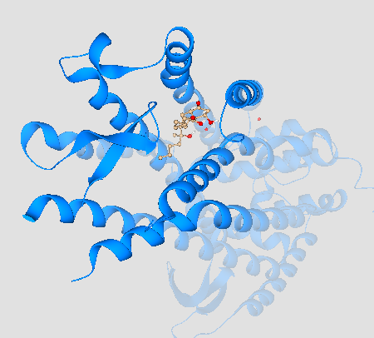
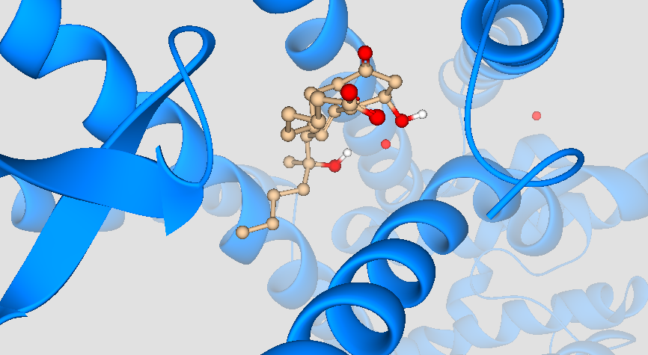
Ribbon diagram showing binding interaction of misoprostol with amino acid residues in the binding site of 6M9T, prostaglandin E2 receptor EP3 subtype. B) Close-up view
A) b)

Slide 12
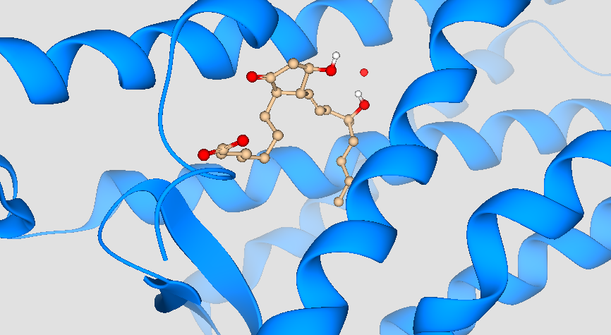
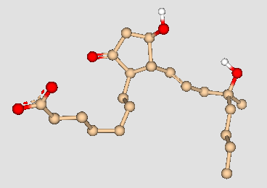
A) Ribbon diagram showing binding interaction of misoprostol with amino acid residues in the binding site of 6M9T, prostaglandin E2 receptor EP3 subtype. B)The binding conformation (stereochemical shape) of misoprostol
a) b)

